Slide 1
Lab 7

Slide 2
Agenda
Objectives
Architecture

Slide 3
Objectives
Learn about the Role definition for UserAccount
Learn about the Work Request flow

Slide 4
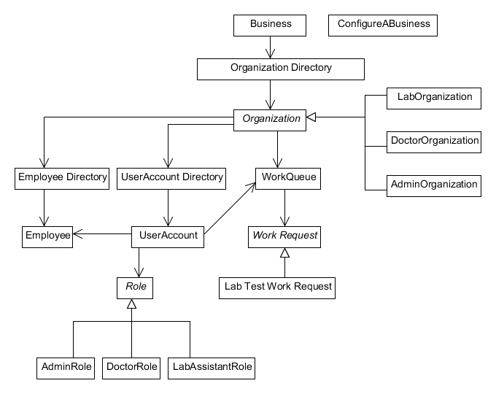
Architecture

